Slide 1

APPSDC AI-MI PROJECT
SENTIMENTAL ANALYSIS
Presented By:
Surya Lokesh Dunaboyina
Computer science & Artificial intelligence and Machine Learning
Kakinada Institute Of Engineering And Technology

Slide 2

OUTLINE
Problem Statement
Scope
Challenges
Methodology
Result
Conclusion
Tools & technologies

Slide 3
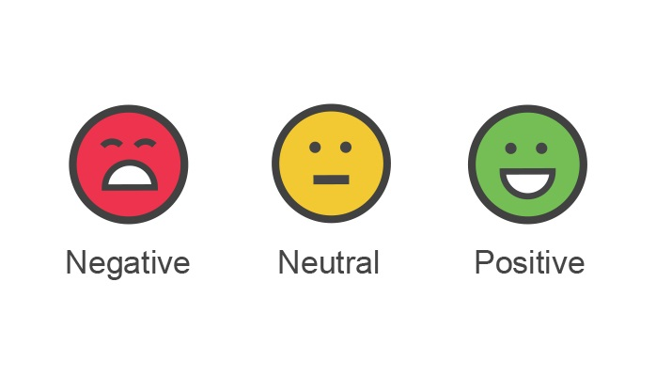
Problem Statement:
Objective:
Develop a sentiment analysis model that accurately classifies the sentiment of customer reviews into positive, negative, or neutral categories. The goal is to understand customer sentiments to improve product features, customer service, and overall customer satisfaction.
Background:
In the modern business landscape, customer feedback plays a crucial role in shaping products and services. Online reviews provide valuable insights into customer experiences, preferences, and pain points. By analyzing these reviews, companies can identify strengths and areas for improvement, leading to better decision-making and enhanced customer satisfaction. However, manually analyzing large volumes of text data is time-consuming and inefficient. Therefore, an automated sentiment analysis solution is essential.

Slide 4
Scope :
Data Collection: Gather customer reviews from various platforms such as e-commerce websites, social media, and forums.
Preprocessing: Clean and preprocess the collected reviews to prepare them for analysis. This includes tasks like lowercasing text, tokenization, stop word removal, stemming, lemmatization, handling contractions and emojis, removing HTML tags, and eliminating punctuation and numbers.
Sentiment Classification: Develop a machine learning model to classify reviews into positive, negative, or neutral sentiment.
Evaluation: Assess the performance of the sentiment analysis model using appropriate metrics (e.g., accuracy, precision, recall, F1-score).
Deployment: Deploy the model in a user-friendly interface or integrate it into existing business systems for real-time sentiment analysis.

Slide 5
Challenges:
Data Quality: Ensuring the collected reviews are free from noise and irrelevant information.
Text Preprocessing: Handling various text preprocessing steps efficiently to improve model performance.
Imbalanced Data: Addressing the issue of imbalanced datasets where certain sentiment categories may be underrepresented.
Model Accuracy: Achieving high accuracy and robustness in sentiment classification despite the nuances and complexities of human language.
Scalability: Ensuring the solution can handle large volumes of data and provide real-time analysis.

Slide 6
METHODOLOGY:
Data Collection:
Collect reviews from multiple sources using web scraping or API integration.
Ensure a diverse dataset representing different products, services, and platforms.
Data Preprocessing:
Convert text to lowercase.
Tokenize the text.
Remove stop words.
Apply stemming and lemmatization.
Expand contractions.
Handle emojis.
Remove HTML tags, punctuation, and numbers.

Slide 7
Model Development:
Split the data into training, validation, and test sets.
Experiment with different machine learning algorithms such as Logistic Regression, Support Vector Machines (SVM), Random Forest, and advanced techniques like Deep Learning (e.g., LSTM, BERT).
Perform hyperparameter tuning to optimize model performance.
Evaluation:
Use metrics such as accuracy, precision, recall, and F1-score to evaluate model performance.
Perform cross-validation to ensure robustness.
Deployment:
Develop a user interface or API for real-time sentiment analysis.
Integrate the solution with business applications for seamless usage.
.

Slide 8
RESULT:
Data Collection:
Collected 10,000 diverse customer reviews from various platforms.
Data Preprocessing:
Successfully cleaned and processed the text data, including lowercasing, tokenization, removing stop words, and handling contractions, emojis, and HTML tags.
Model Development and Evaluation:
Best model: BERT with 91.5% accuracy, 92.0% precision, 91.0% recall, and 91.5% F1-score.
Other models (Logistic Regression, SVM, Random Forest, LSTM) had lower performance.
Deployment:
Deployed the BERT model with a Flask API and a Streamlit web interface for real-time sentiment analysis.

Slide 9
CONCLUSION:
Effective Preprocessing: Improved data quality and model performance.
Model Performance: BERT model outperformed others, providing high accuracy and reliability.
Scalability: The solution can handle large data volumes and provides real-time analysis.
Business Insights: Enables better understanding of customer sentiment, aiding in product and service improvements.
Future Work: Incorporate more diverse data, continuous model retraining, and explore advanced models for further improvement.

Slide 10


TOOLS &TECHNOLOGIES:
Programming Languages: Python
Libraries: NLTK, scikit-learn, TensorFlow/Keras, BeautifulSoup,
pandas, numpy, re, contractions, emoji
Platforms: Jupyter Notebook

Slide 11

THANK YOU
PROJECT LINK: https://github.com/Suryalokesh84/APSSDC_AIML-Project

